Slide 1
Battleship
A classic board game implemented with Java Swing
By: Skyler Thompson, Garrett Ellison, Alex Waitkus, and Anish Gilani

Slide 2
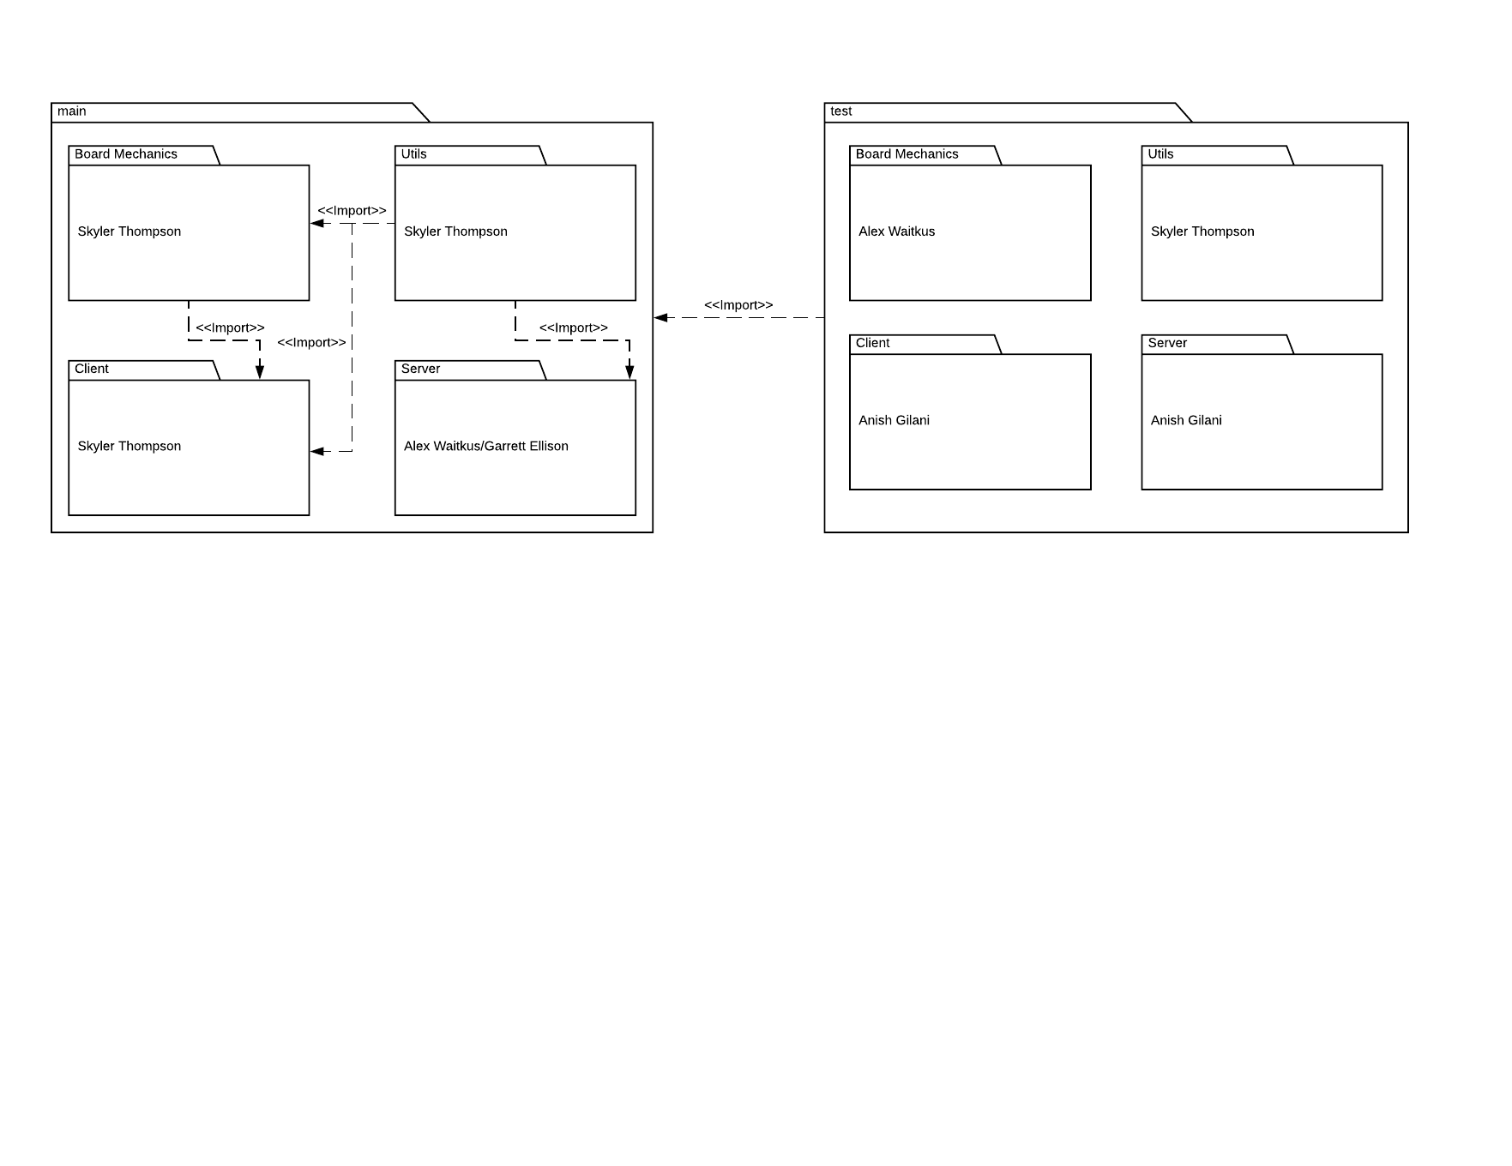
Package Diagram

Slide 3
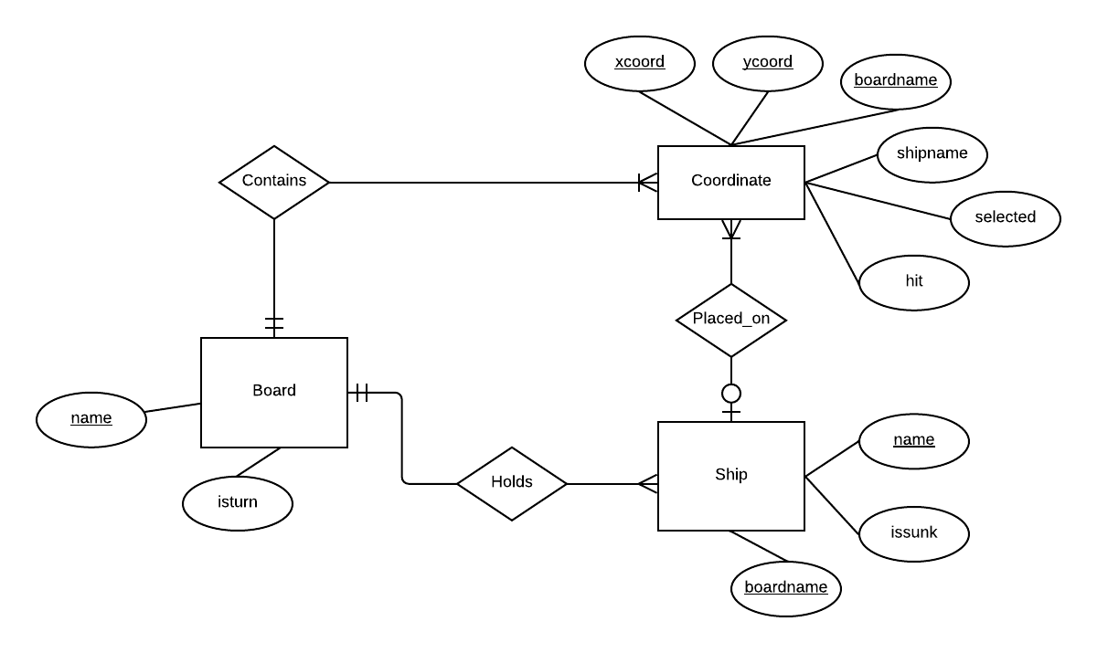
ER Diagram

Slide 4
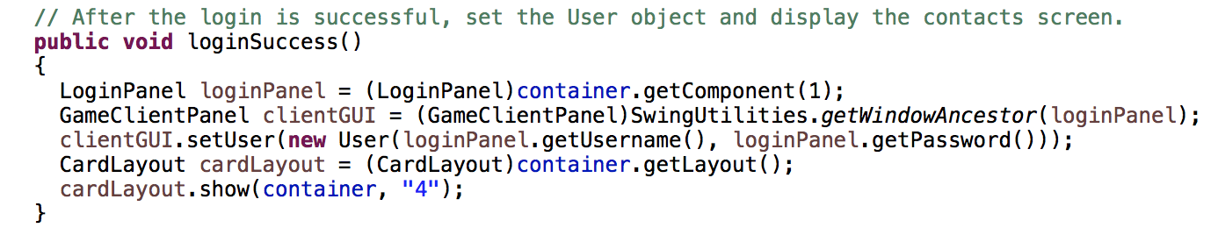
Functional Requirement Example
The player can join another game(loginSuccess())

Slide 5
Use Case Example
Use Case: BeginGame
Actor: Player
1. Two players are waiting for a game to begin
2. The system creates a new game and both players are presented with two game boards filled with ships, and a way to submit coordinates (JButtons).
Entry Condition:
Both players are logged into the system and are ready for the game to begin.
Exit Condition:
A new game begins

Slide 6
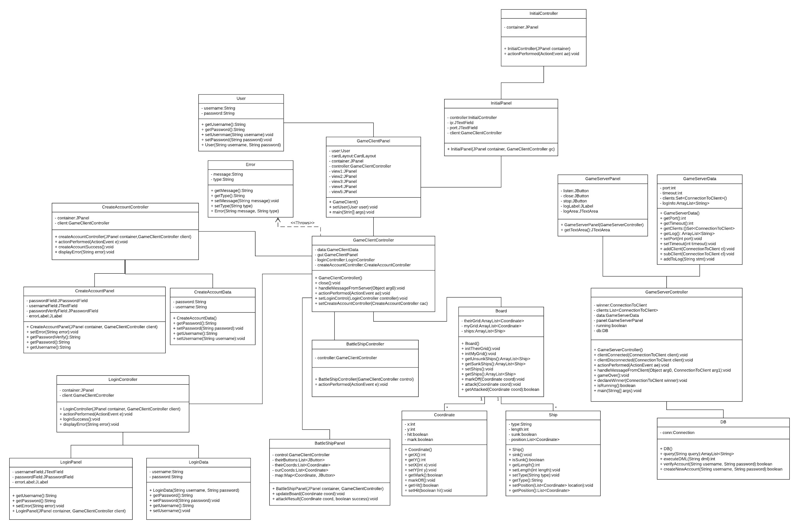
Final Class Diagram

